Slide 1
Figure Workflow: Matlab to Latex
How to make sufficiently nice figures as quickly as possible

Slide 2
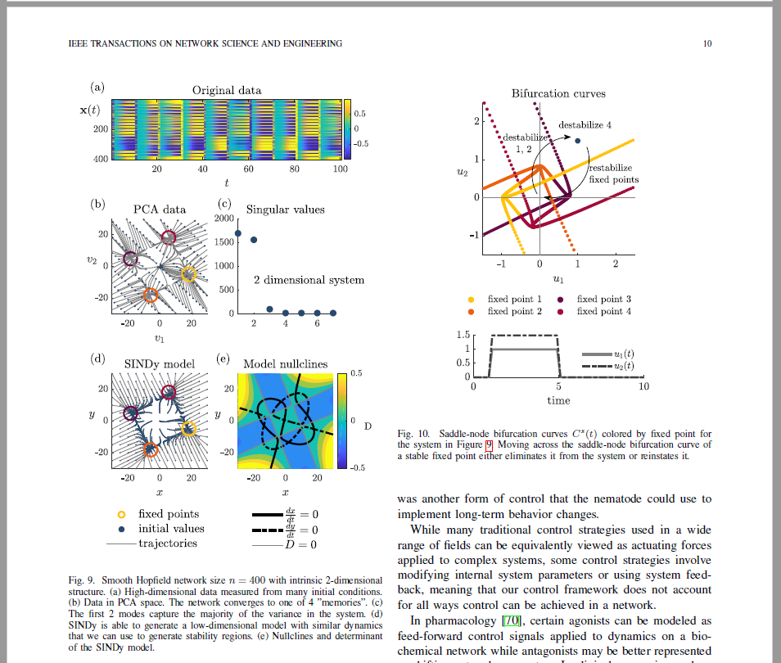
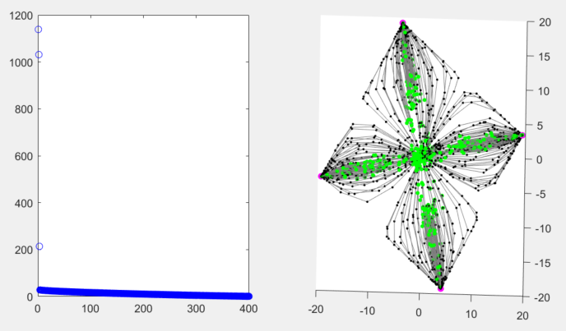
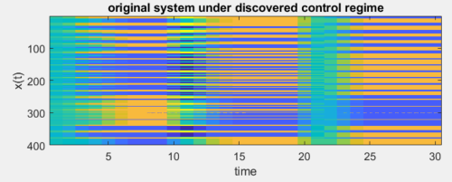
Initial Matlab figures
Final paper figures
Nice 2D system
Many,
many,
changes

Slide 3
What do we want in a figure?
Standardization: fonts, size, spacing, colors, etc...
QUICK and EASY to make changes
Easy to change file type: pdf, eps, png, …
Easy to use in different final products: paper, presentation, poster, dissertation, tutorial….
Quick to make the first time
Quick to change
No repeat work
Flexibility

Slide 4
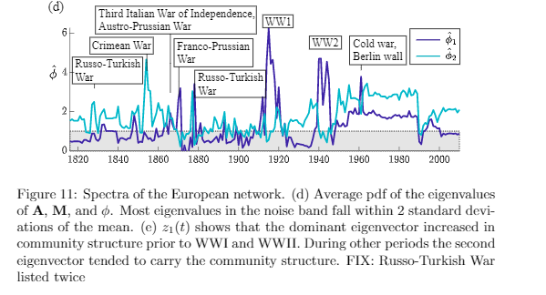
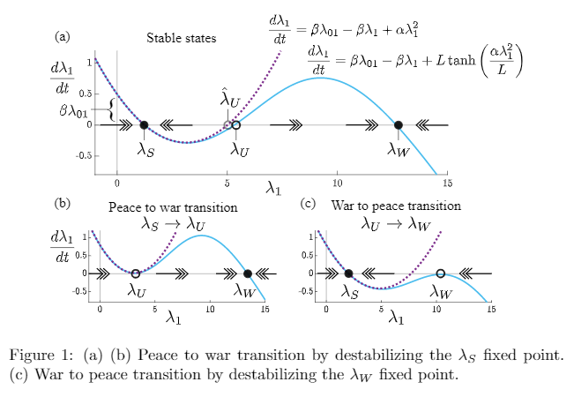
What goes into a figure panel?
Subfigures
Set colors, line widths, line types
Tick labels, spacing, size, fonts
X,Y labels, location, size, fonts
Legends, titles
Annotations
Latex equations
Shading
Arrows, boxes, circles, cartoons,
File size, file type, file storage
Set panel size
Matlab
Inkscape
Latex

Slide 5
Where you can but should not make each component
Subfigures
Set colors, line widths, line types
Tick labels, spacing, size, fonts
X,Y labels, location, size, fonts
Legends, titles
Annotations
Latex equations
Shading
Arrows, boxes, circles, cartoons,
File size, file type, file storage
Set panel size
Subfigures
Set colors, line widths, line types
Tick labels, spacing, size, fonts
X,Y labels, location, size, fonts
Legends, titles
Annotations
Latex equations
Shading
Arrows, boxes, circles, cartoons,
File size, file type, file storage
Set panel size
Matlab
Matlab
Latex
-Tikz
-Overpic
Latex

Slide 6
Where you can but should not make each component
Subfigures
Set colors, line widths, line types
Tick labels, spacing, size, fonts
X,Y labels, location, size, fonts
Legends, titles
Annotations
Latex equations
Shading
Arrows, boxes, circles, cartoons,
File size, file type, file storage
Set panel size
Cons
Lots of code for simple things
Limited mobility
Easily breaks
Difficult to align across multiple subfigures
Difficult to go back and make changes
Must re-run code for each change
Heavy constraints on subfigures
Can’t incorporate cartoons or other non-Matlab objects easily
Matlab
Latex

Slide 7
Where you can but should not make each component
Subfigures
Set colors, line widths, line types
Tick labels, spacing, size, fonts
X,Y labels, location, size, fonts
Legends, titles
Annotations
Latex equations
Shading
Arrows, boxes, circles, cartoons,
File size, file type, file storage
Set panel size
Matlab
Cons
Lots of code for simple things
Limited mobility
Easily breaks
Difficult to align across multiple subfigures
Difficult to go back and make changes
Heavy constraints on subfigures
Incompatible with certain latex packages and classes
Latex
- TikZ
- Overpic

Slide 8
The right way
Subfigures
Set colors, line widths, line types
Tick labels, spacing, size, fonts
X,Y labels, location, size, fonts
Legends, titles
Annotations
Latex equations
Shading
Arrows, boxes, circles, cartoons,
File size, file type, file storage
Set panel size
Matlab
Pros
Easy to make changes without messing up formatting or other work
Standardization
Very flexible for subfigures, annotations, cartoons, placement
Easy to place into a latex file
Cons
Inkscape has an overwhelming number of features…however, you only need a few of them
Inkscape
Latex

Slide 9
Tutorial 1 – basics
Create a figure panel

Slide 10
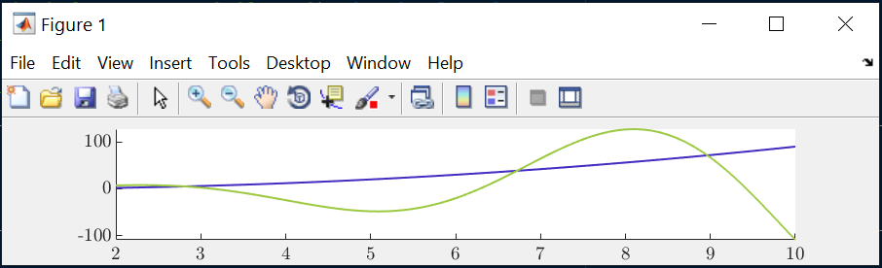
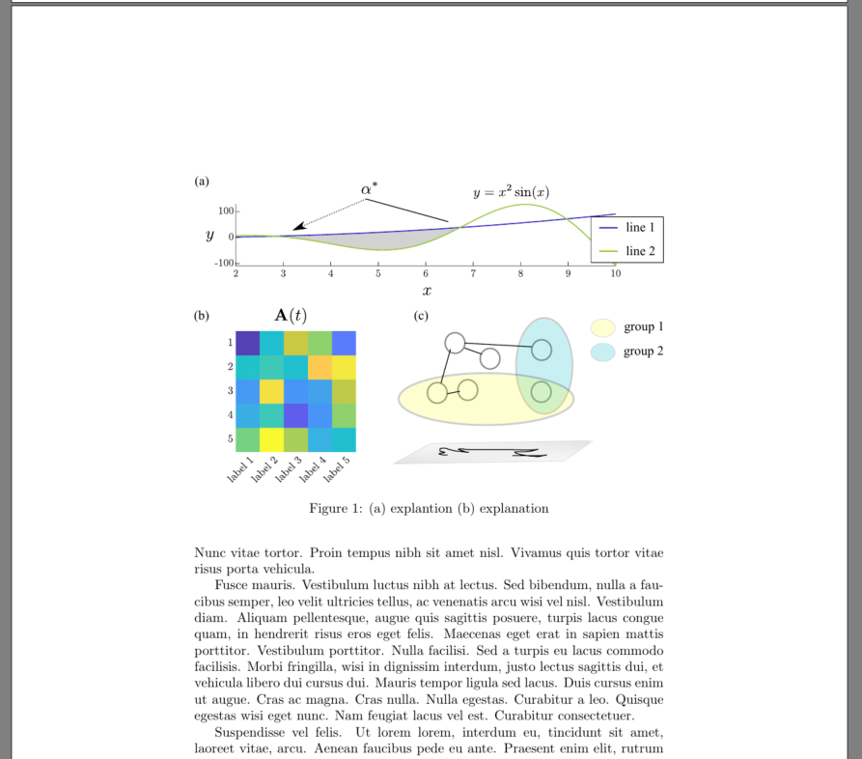
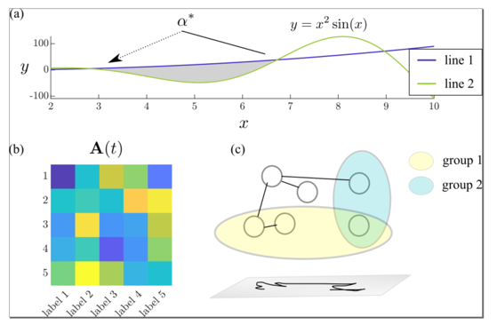
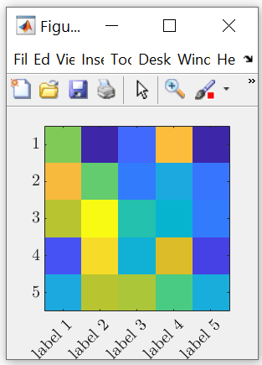
Workflow
Matlab/Python
Inkscape
Latex
Set subfigure sizes and tick labels
Compose subfigures,
Make all labels, annotations, and cartoons
Insert final panel figure into latex file

Slide 11
Workflow
Matlab/Python
Inkscape
Latex
Generate and save INDIVIDUAL bare bones figures as pdfs (or eps) at a RESONABLE RESOLUTION
Set all….
Figure SIZES
Figure tick VALUES, SIZES, FONTS
Plot colors, linewidths
DON’T: combine multiple figures using subplots, add titles, x or y labels
Import bare bones figures
Create panel
Add all…
Labels
Annotations,
Legends,
Arrows,
Shapes,
Cartoons,
Anything else you want in final latex figure
Save panel as pdf,
ex) “demo_fig.pdf”
Insert final panel figure into latex file
\begin{figure}
\centering
\includegraphics[width=1.0\linewidth]
{figures/demo_fig.pdf}
\caption{(a) blah blah (b) blah..} \label{fig:demo}
\end{figure}
DON’T: add any code to add stuff to figure or combine figures,
DON’T: use TikZ, Overpick, subfig package. Do everything you need to do in Inkscape

Slide 12
Data organization
Project Folder
Paper.tex
Make_figures.m
Figure's folder
Sub_fig2.pdf
Sub_fig1.pdf
Sub_fig3.pdf
Mega_figure.svg
Mega_figure.pdf

Slide 13
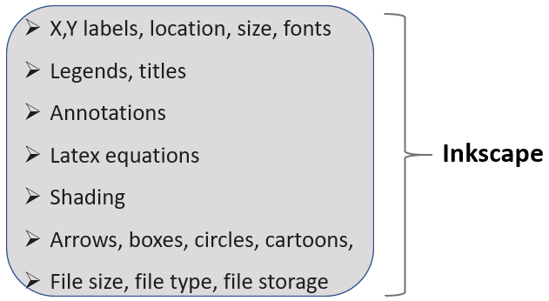

Step 1: Make subfigures in Matlab/Python
Subfigures
Set colors, line widths, line types
Tick labels, spacing, size, fonts
Tutorial 1 - basics\
Demo_make_figs.m
Matlab

Slide 14
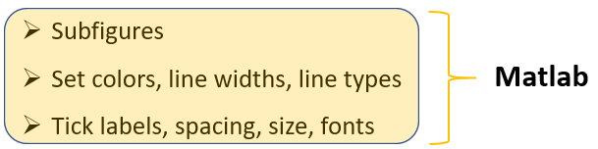
Step 2: Compose panel in Inkscape
Tutorial 1 - basics\figures\
demo_panel.svg
X,Y labels, location, size, fonts
Legends, titles
Annotations
Latex equations
Shading
Arrows, boxes, circles, cartoons,
File size, file type, file storage
Inkscape

Slide 15
Step 3: Insert final figure into latex
Tutorial 1 - basics\
demo_paper.tex
Set panel size
Latex

Slide 16
Tutorial 2 – colors (advanced)
How to find, create, and use custom, professional color palettes

Slide 17
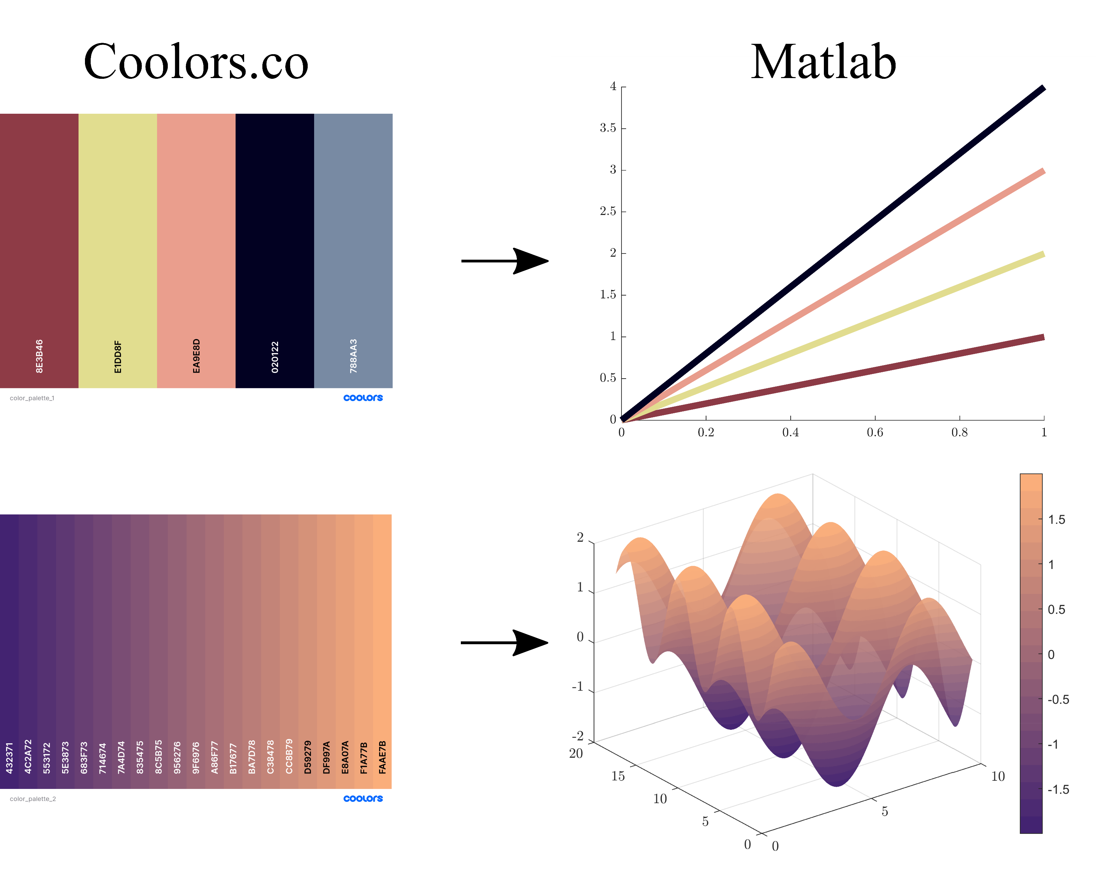
Goal - use a professional color palette for figures

Slide 18
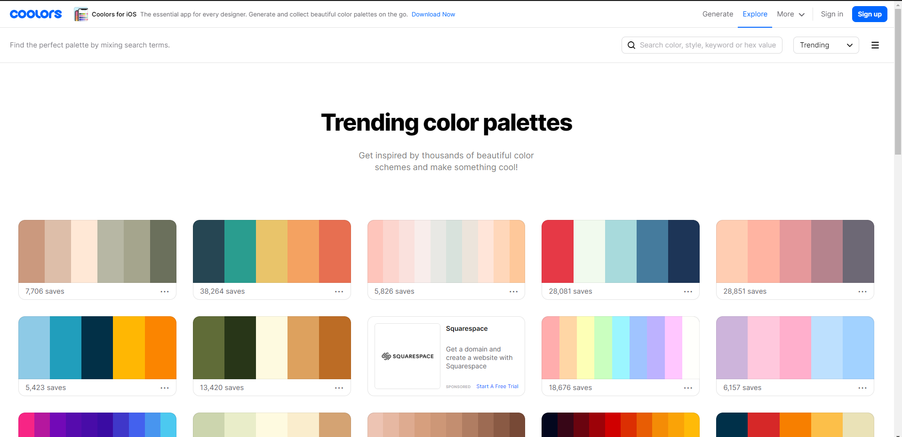
Step 1 - find a website that generates palettes
Coolors.co is great because it lets you export hex color codes
https://coolors.co/

Slide 19
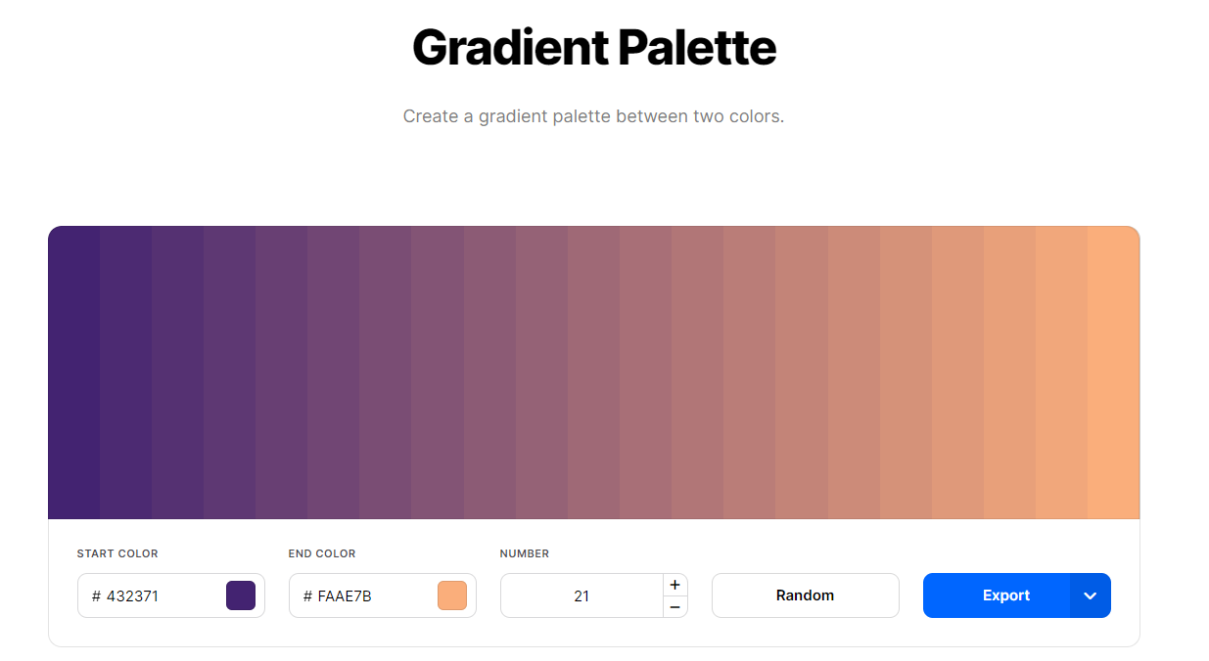

Step 2 – Export palette as a hex color array
https://coolors.co/gradient-palette/432371-faae7b?number=21
Online generated palette
/* Array */ ["432371","4C2A72","553172","5E3873","683F73","714674","7A4D74","835475","8C5B75","956276","9F6976","A86F77","B17677","BA7D78","C38478","CC8B79","D59279","DF997A","E8A07A","F1A77B","FAAE7B"]
Hex color array,
paste into Matlab

Slide 20
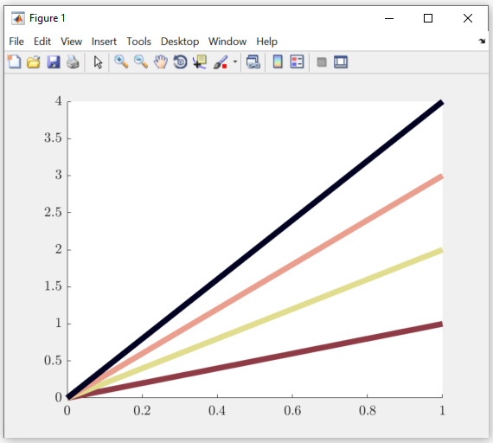
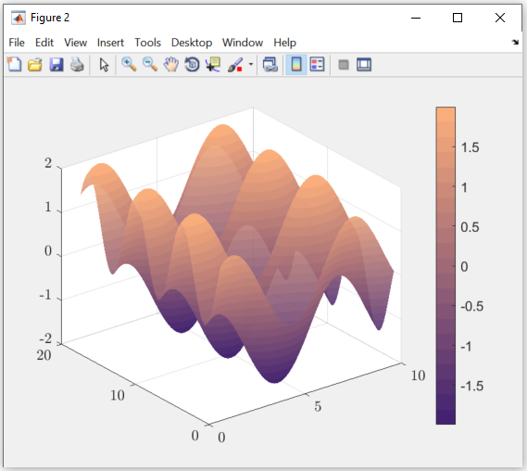
Step 3 – Convert hex to RGB colors in Matlab using a hex-to-RGB color converter package¹
Tutorial 2 – colors(advanced)\
demo_make_colors.m
¹Chad Greene (2021). rgb2hex and hex2rgb
(https://www.mathworks.com/matlabcentral/fileexchange/46289-rgb2hex-and-hex2rgb),
MATLAB Central File Exchange. Retrieved February 13, 2021.

